Slide 1
Sales Insights - Data Analysis Project using Tableau
By – KHUSHBOO KuMARI

Slide 2
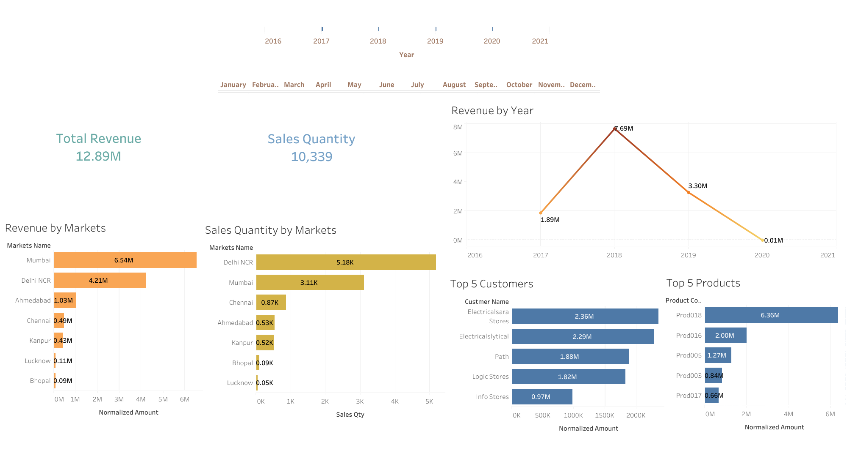

Slide 3
